Slide 1
Matrix Sparsification
A Note on Element-wise Matrix Sparsification via a Matrix-valued Bernstein Inequality
James Milne
Nicholas Kwock

Slide 2
Information on the paper
Authors: Petros Drineas, Anastasios Zouzias
Published: March 15th, 2011
Venue of publication: Information Processing Letters

Slide 3
Matrix Sparsification Motivation
Given a matrix A, construct a sparse matrix Ã that is close to A in expectation
||A - Ã||₂ ≤ ε||A||₂
Sparse matrices are simpler to use in computation due to the large amount of zero entries
Eigenvector computations
Semi-definite programming solvers
Matrix completion problems

Slide 4

Algorithm Overview
Truncation: Zero out all elements that are less than $\frac{ε}{2n}$ * ||A||₂ to make Â
Sampling: (i.i.d. trials with replacement) randomly sample s elements from Â with probability based on their magnitude
Sampling with probability based on magnitude to get a sparse matrix as opposed to sampling uniformly, which would be close in expectation but not sparse
Construct Sparse Matrix: Using the Matrix-Valued Bernstein Inequality, we construct matrix Ã such that larger values are weighted lower and smaller values are weighted higher
This preserves the expected value

Slide 5

Algorithm Cost and Guarantees
Runtime Complexity: O(n²s)
Space Complexity: O(n²)
The relative error is within a given 0 < ε < 1 , with success probability 1 - $n^{−1}$
$$\frac{{\left\|A−\tilde{A}\right\|}_{2}}{{\left\|A\right\|}_{2}}≤ε$$

Slide 6
Algorithm Analysis

Slide 7
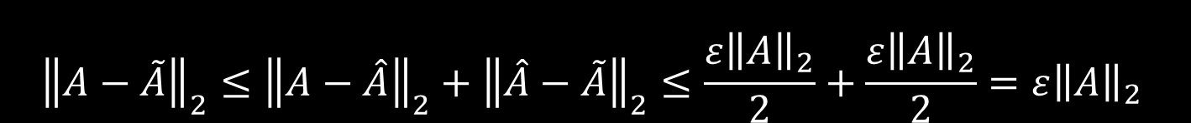
Proving the Guarantee
Triangle Inequality
$${\left\|A−\tilde{A}\right\|}_{2}≤{\left\|A−\hat{A}\right\|}_{2}+{\left\|\hat{A}−\tilde{A}\right\|}_{2}≤\frac{ε{\left\|A\right\|}_{2}}{2}+\frac{ε{\left\|A\right\|}_{2}}{2}=ε{\left\|A\right\|}_{2}$$
Truncation
Matrix Construction

Slide 8
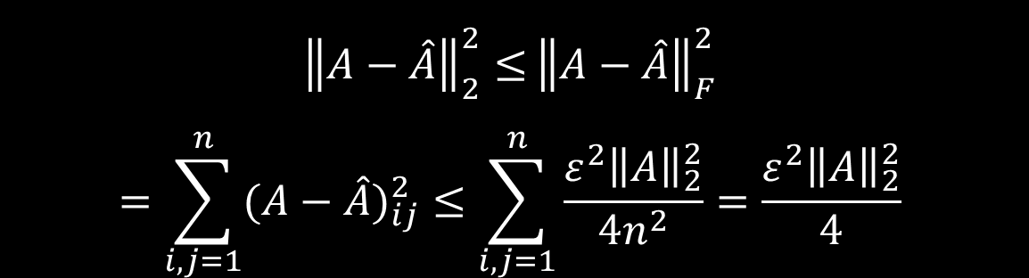
Truncation
Idea: Remove relatively small elements so that these values will not be sampled. During the construction of the sparse matrix, these values would be scaled up greatly, which would skew the variance of the sparse matrix
${\left\|A−\hat{A}\right\|}_{2}^{2}≤$ ${\left\|A−\hat{A}\right\|}_{F}^{2}$
$$=\sum_{i,j=1}^{n}{{(A−\hat{A})}_{ij}^{2}}≤\sum_{i,j=1}^{n}{\frac{ε^{2}{\left\|A\right\|}_{2}^{2}}{\text{4}n^{2}}}=\frac{ε^{2}{\left\|A\right\|}_{2}^{2}}{4}$$
Since we remove values smaller than ε||A||₂/2n, the greatest difference between an element in A and Â is ε||A||₂/2n

Slide 9
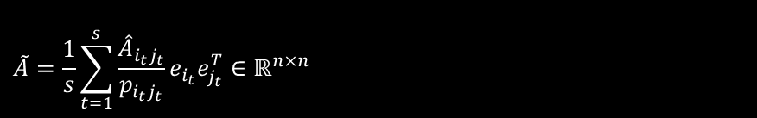

Sampling and Construction
With s trials, each element has probability p_{ij} to be chosen (i.i.d. with replacement)
$$p_{ij}=\frac{A_{ij}^{2}}{{\left\|A\right\|}_{F}^{2}}$$
Construct the sparse matrix
$$\tilde{A}=\frac{1}{s}\sum_{t=1}^{s}{\frac{{\hat{A}}_{i_{t}j_{t}}}{p_{i_{t}j_{t}}}e_{i_{t}}e_{j_{t}}^{T}}∈ℝ^{n×n}$$

Slide 10

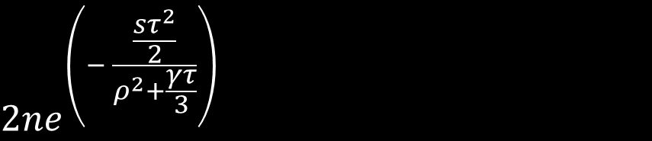
Matrix Valued Bernstein Inequality
Idea: To bound how far a sum of random matrices deviates from its mean
$$\left\|\frac{1}{s}\sum_{t=1}^{s}{M_{t}}\right\|≤τ$$
M_{t} - Zero mean, random matrix
s - number of samples
𝝉 - Deviation from the mean
With failure probability of at most
$$2ne^{\left(− \frac{\frac{sτ^{2}}{2}}{ρ^{2}+\frac{γτ}{3}}\right)}$$

Slide 11


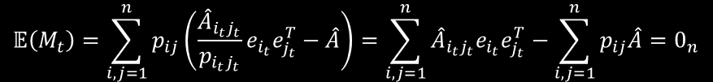

Sampling and Construction
Want ${\left\|\hat{A}−\tilde{A}\right\|}_{2}≤\frac{ε{\left\|A\right\|}_{2}}{2}$
$$\left\|\frac{1}{s}\sum_{t=1}^{s}{M_{t}}\right\|≤τ$$
$$M_{t}=\frac{{\hat{A}}_{i_{t}j_{t}}}{p_{i_{t}j_{t}}}e_{i_{t}}e_{j_{t}}^{T}−\hat{A}$$
$$\frac{1}{s}\sum_{t=1}^{s}{M_{t}}=\frac{1}{s}\sum_{t=1}^{s}{\left[\frac{{\hat{A}}_{i_{t}j_{t}}}{p_{i_{t}j_{t}}}e_{i_{t}}e_{j_{t}}^{T}−\hat{A}\right]}=\tilde{A}−\hat{A}$$
$$𝔼\left(M_{t}\right)=\sum_{i,j=1}^{n}{p_{ij}\left(\frac{{\hat{A}}_{i_{t}j_{t}}}{p_{i_{t}j_{t}}}e_{i_{t}}e_{j_{t}}^{T}−\hat{A}\right)}=\sum_{i,j=1}^{n}{{\hat{A}}_{i_{t}j_{t}}e_{i_{t}}e_{j_{t}}^{T}}−\sum_{i,j=1}^{n}{p_{ij}\hat{A}}=0_{n}$$

Slide 12
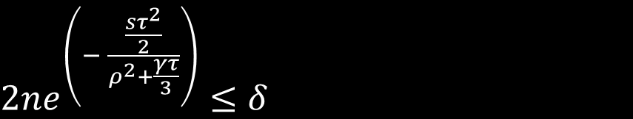



Choosing Sample Size S
$2ne^{\left(− \frac{\frac{sτ^{2}}{2}}{ρ^{2}+\frac{γτ}{3}}\right)}≤δ$
Let δ be $\frac{1}{n}$, $τ=\frac{ε{\left\|A\right\|}_{2}}{2}$, $γ$ and $ρ^{2}$are given
$$s=\frac{28n sr\left(A\right)ln⁡(n\sqrt{2})}{ε^{2}}$$
where $sr\left(A\right)=\frac{{\left\|A\right\|}_{F}^{2}}{{\left\|A\right\|}_{2}^{2}}$ is the stable rank of A
Pessimistic upper bound

Slide 13
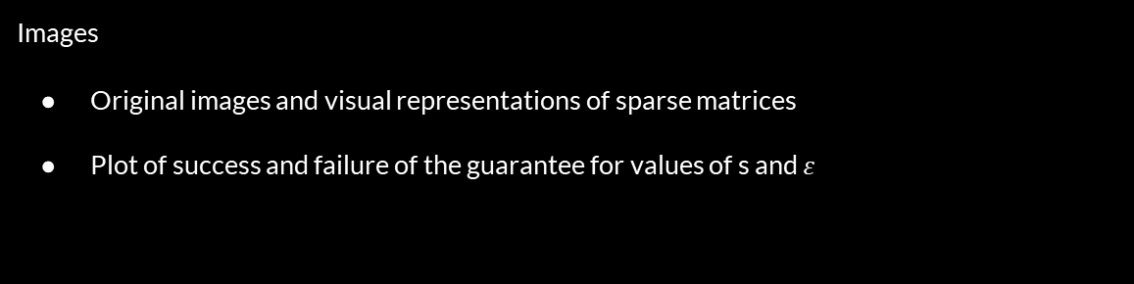
Experiments
Data: Low resolution images
Has underlying structure - makes sense to sparsify it (random matrices are not real data)
Has low stable rank which makes ‘required’ samples s, lower
Resize images to low resolution (50x50 pixels) and grayscale
Images
Original images and visual representations of sparse matrices
Plot of success and failure of the guarantee for values of s and $ε$

Slide 14

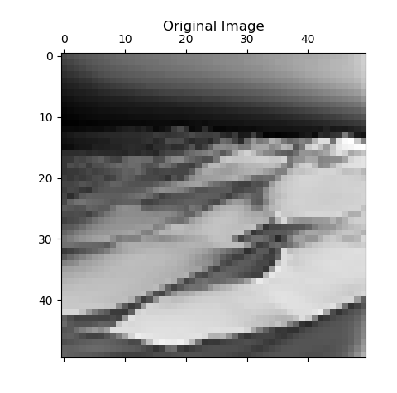
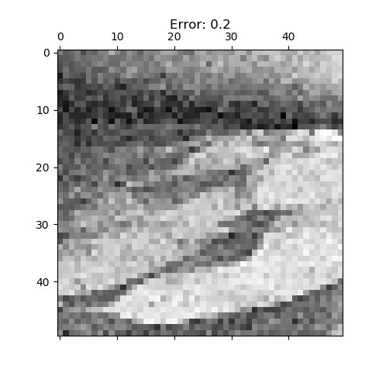
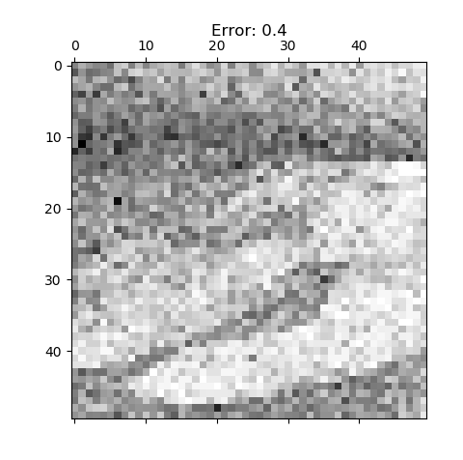
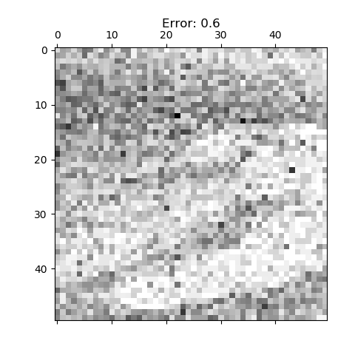
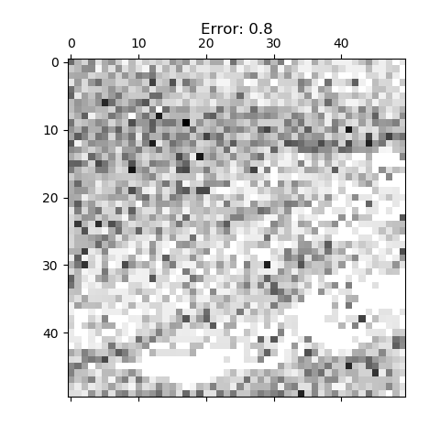

Slide 15

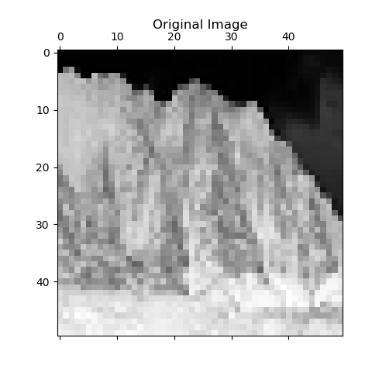
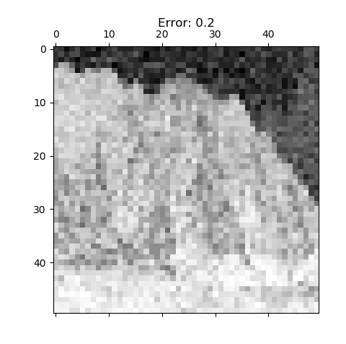
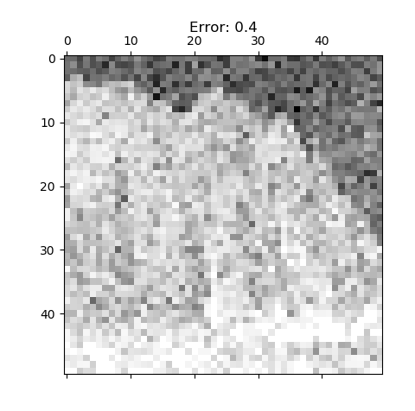
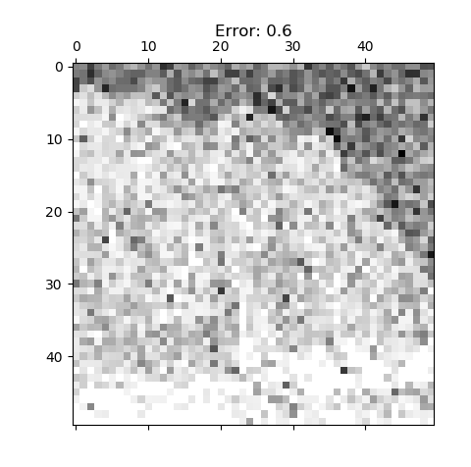
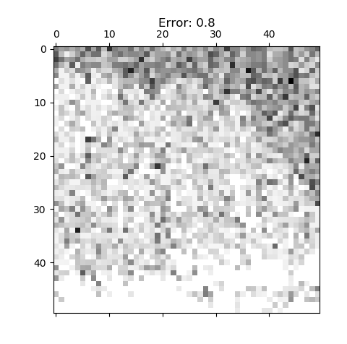

Slide 16

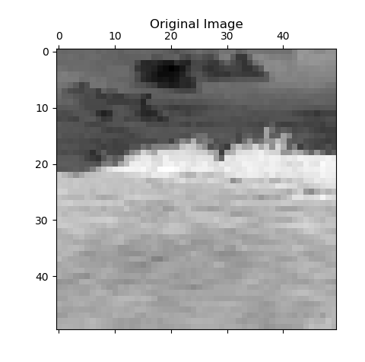
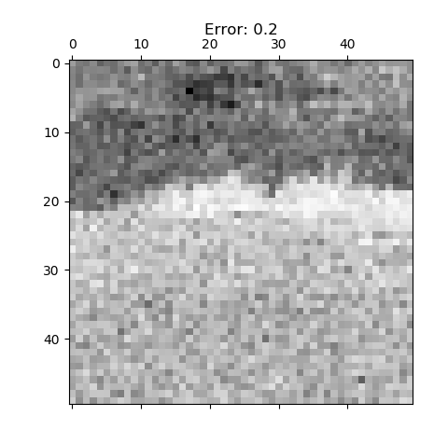
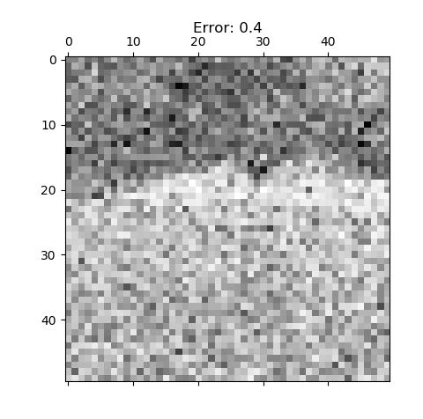
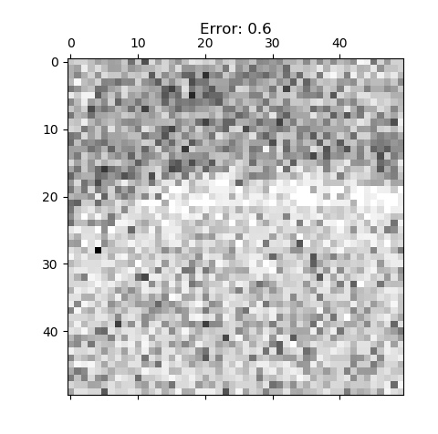
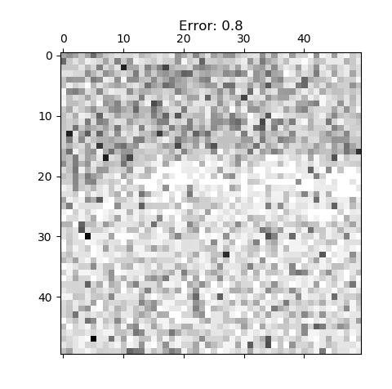

Slide 17
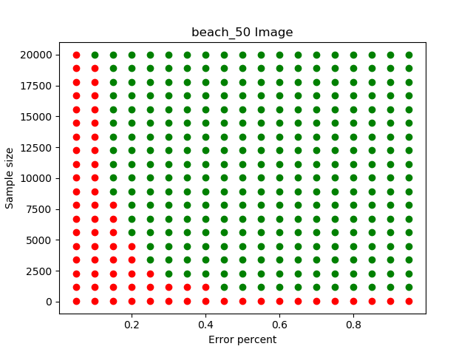

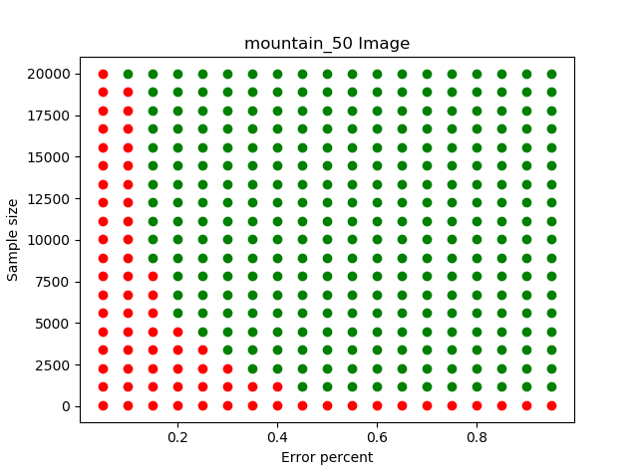

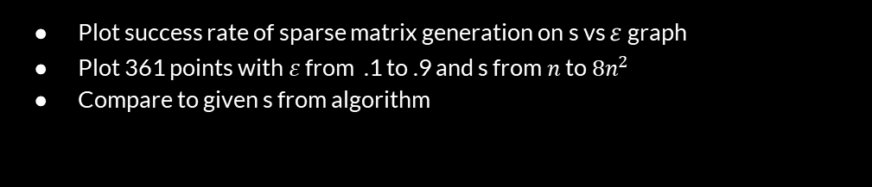
Experiments
Plot success rate of sparse matrix generation on s vs $ε$ graph
Plot 361 points with $ε$ from .1 to .9 and s from $n$ to $8n^{2}$
Compare to given s from algorithm
$$\frac{{\left\|A−\tilde{A}\right\|}_{2}}{{\left\|A\right\|}_{2}}≤ε$$

Slide 18
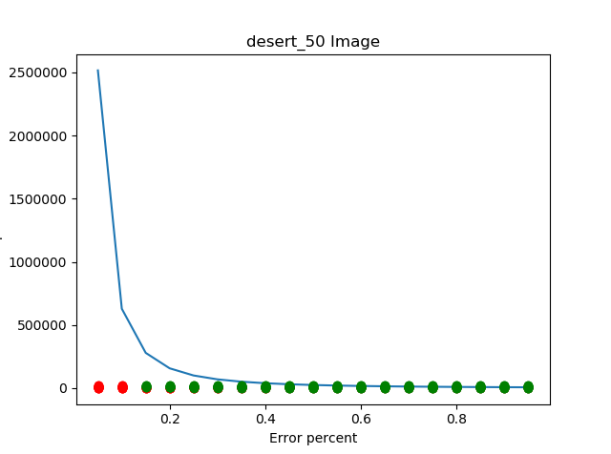
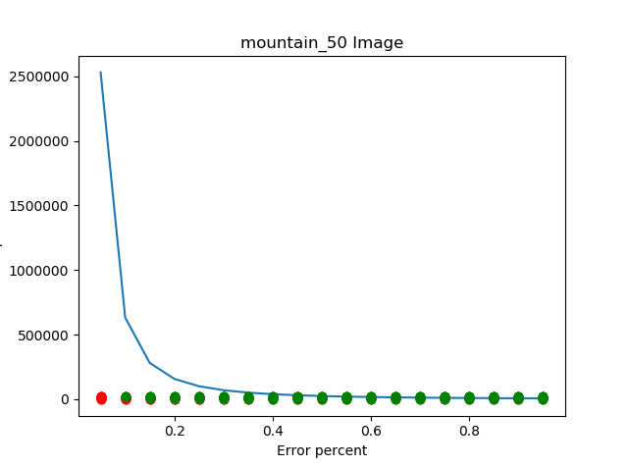
s is a pessimistic upper bound

Slide 19
Conclusion
Algorithm makes a sparse matrix that is close to the original in expectation
Sampling with probability based on magnitude to get a sparse matrix as opposed to sampling uniformly, which would be close in expectation but not sparse
Number of samples s required to make sparse matrix bounded by Bernstein Inequality
Can sample less than s values and still get a matrix that is within the given error

